Slide 1
Introduction to MLOps

Slide 2
Author Introduction
Lavi Nigam
Data Scientist @ Gartner

Slide 3




What are we going to learn today?
What we Have? | The New Stuff? | What we should have?
Current ML Pipeline New Age ML Pipeline | Model & Data Versioning Model Interpretability AutoML Multi Model Analysis Model & Data Bias Distributed Data Science Data Interactive Apps | MLOps Continuous Deployment & Integration Model Production API

Slide 4

Alright, but why do we care for all of this?

Slide 5
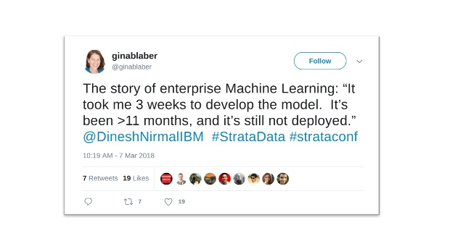

Slide 6


But, isn't the Data Science we do already Enterprise Ready?

Slide 7


The Current ML Pipeline
https://docs.microsoft.com/en-us/azure/machine-learning/team-data-science-process/media/lifecycle/tdsp-lifecycle2.png

Slide 8
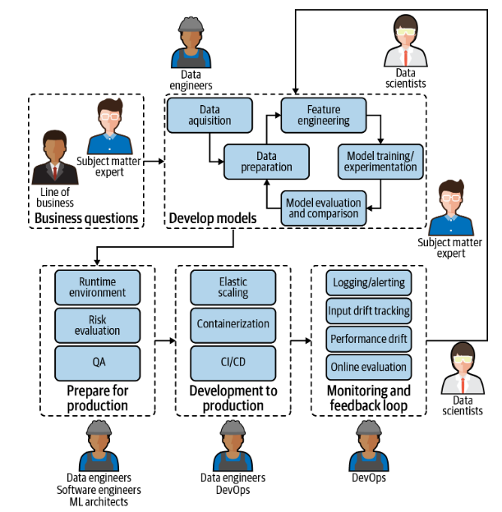
New Age ML Pipeline

Slide 9
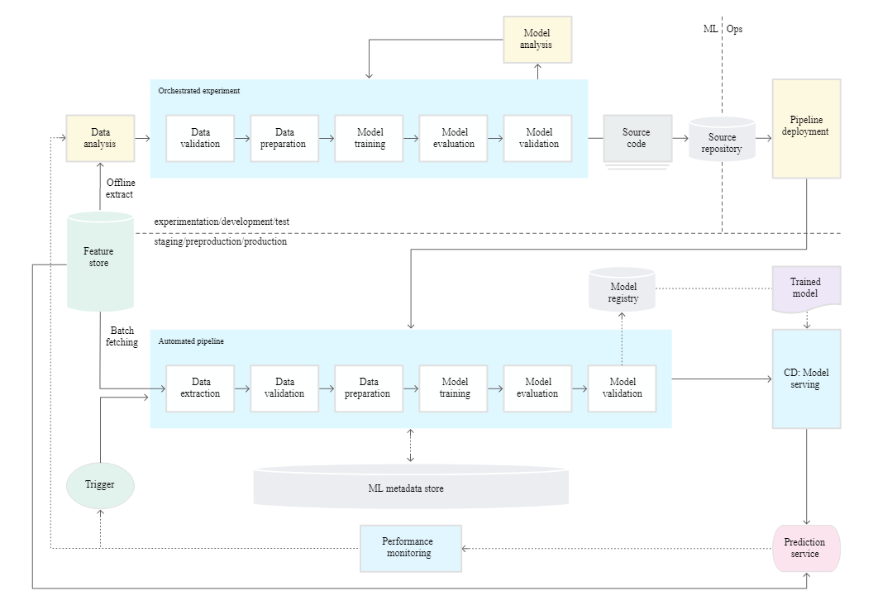
New Age ML Pipeline - GCP
https://cloud.google.com/solutions/images/mlops-continuous-delivery-and-automation-pipelines-in-machine-learning-3-ml-automation-ct.svg

Slide 10
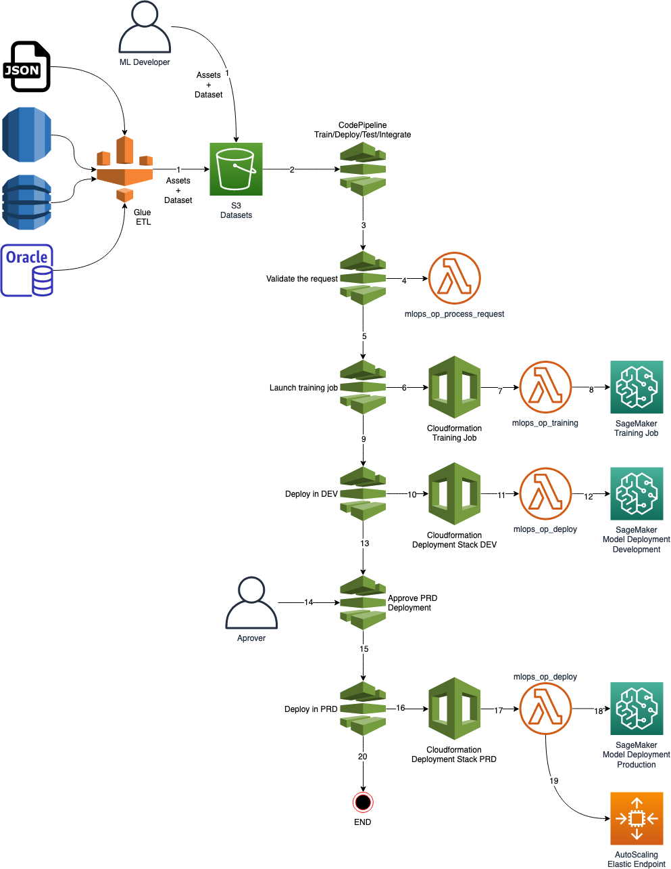
New Age ML Pipeline - AWS
https://raw.githubusercontent.com/awslabs/amazon-sagemaker-mlops-workshop/master/imgs/MLOps_Train_Deploy_TestModel.jpg

Slide 11
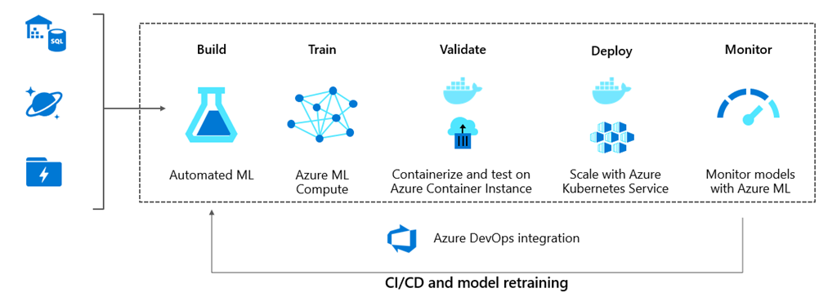
New Age ML Pipeline - Azure
https://azurecomcdn.azureedge.net/mediahandler/acomblog/media/Default/blog/575cb9f3-2beb-4c90-a3b7-a8ee645ce24e.png

Slide 12
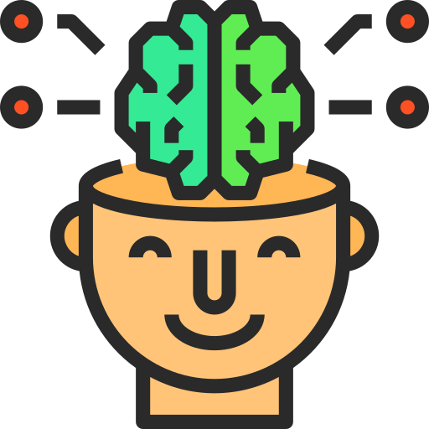
Alright, so many new things! Who says we need them?

Slide 13
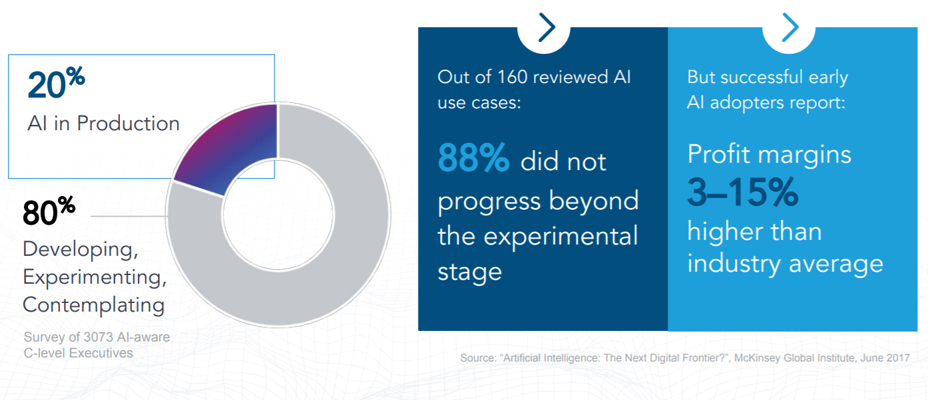
What the experts say
"As the market for artificial intelligence (AI) technologies and techniques matures and grows, users and partners require more and better access to innovative AI models, applications and platforms."
- Gartner, Emerging Technologies and Trends Impact Radar: Artificial Intelligence, 13 November 2019
“Technology innovation leaders are keen to apply DevOps principles for AI and ML projects, but they often struggle with architecting a solution for automating end-to-end ML pipelines across data preparation, model building, deployment and production due to lack of process and tooling know-how.”
- Gartner, Accelerate Your Machine Learning and Artificial Intelligence Journey Using These DevOps Best Practices, 12 November 2019, Arun Chandrasekaran and Farhan Choudhary

Slide 14
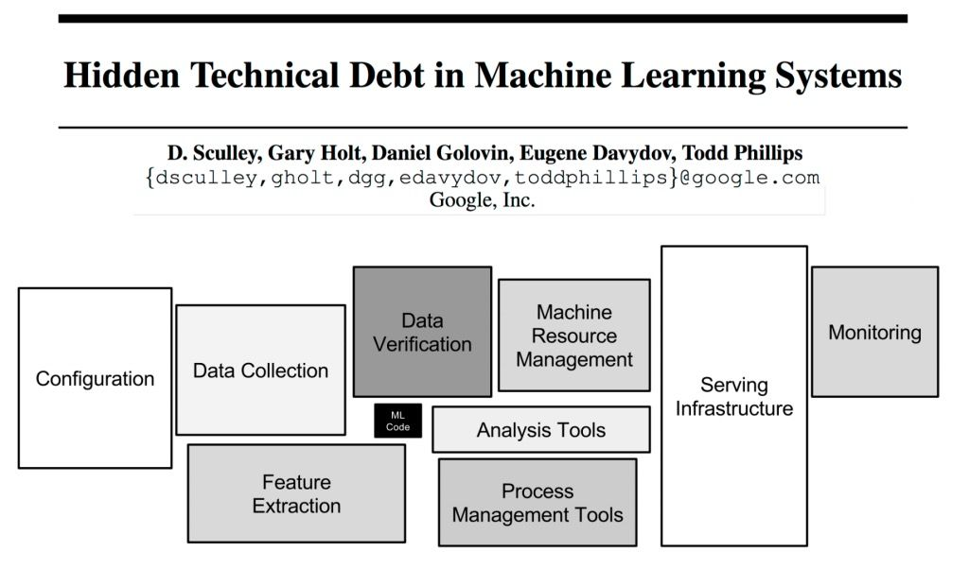
The Bigger Picture
https://papers.nips.cc/paper/5656-hidden-technical-debt-in-machine-learning-systems.pdf

Slide 15

Fine, I am sold! Take my money & explain these - PLEASE!

Slide 16
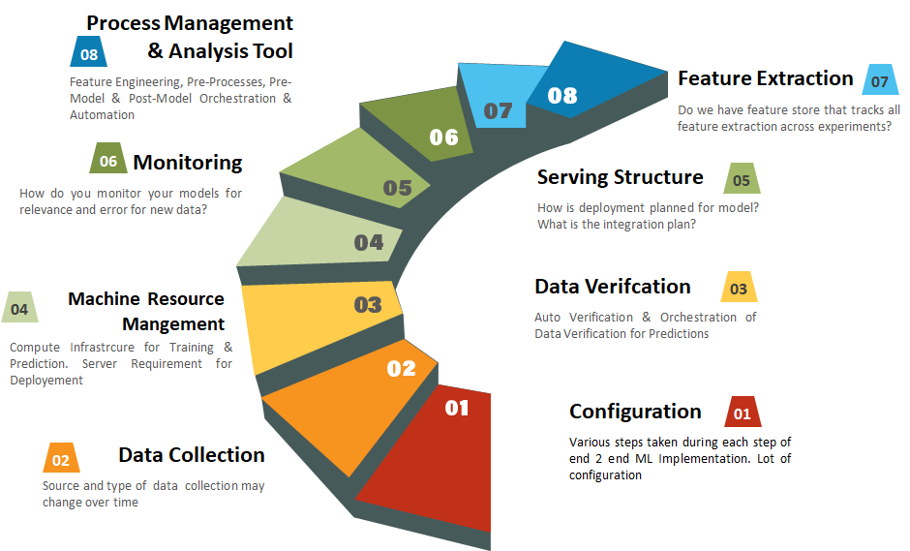
Real World Machine Learning

Slide 17





What is MLOPs
Extension to DevOps
ML & DS asset
Practices , Frameworks & Tools
Maintainability,
Testability & Scalability
Ethics, Bias & Fairness
MLOPS is extension of DevOps, software codes don’t degrade ML models does.
Your python code, model, features , hyperparameters, charts can be saved for later purpose
MLOps is a combination of multiple practices and frameworks to facilitate continuous monitoring and retraining so that the algorithms may continue to be used in production
AI models should be scalable, its should be tested and maintained by properly monitoring the overall process
Design algorithms that make fair predictions, it should remove data and model bias. AI system make important decisions, we need to be aware of limitations

Slide 18
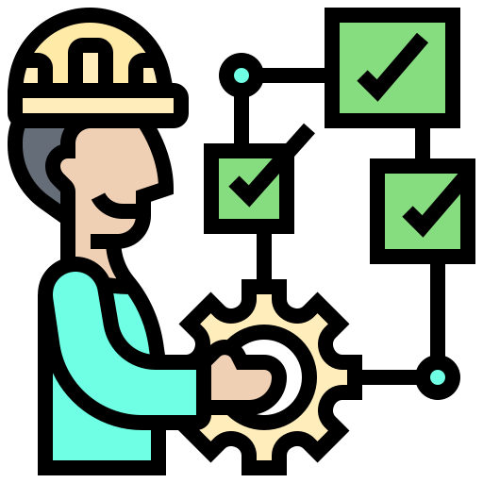
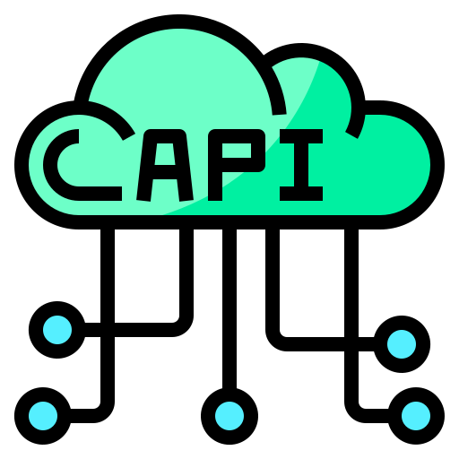

What MLOps is Not
Jupyter Notebooks in production environment
Building API of your Model
Considering models as First Class citizen

Slide 19
Features of MLOps
Governance, Continuous Integration & Continuous learning
Model Development
Model development is an iterative process, in which many models are derived, tested and built upon until a model fitting the desired criteria is built
Set of activities, policies and procedures which formalize model and model risk management activities. MLOPS uses CI/CD practices that enable application development teams to deliver code changes more frequently and reliably.
Production & Deployment
Model Interpretation
Model Deployment involves making the model available in production environments, so they can be used to make predictions and provide value to other systems
Explainable AI is a set of tools and frameworks to help you understand and interpret predictions made by your machine learning models
Model and Data Monitoring
Iteration and Life cycle
Monitoring should be designed to provide early warnings to the myriad of things that can go wrong with a production ML model
Breaks ML process into smaller steps like Data Collection, Data Normalization, Data Modelling, Model Training and Feature Engineering & Deploying Models to Production

Slide 20
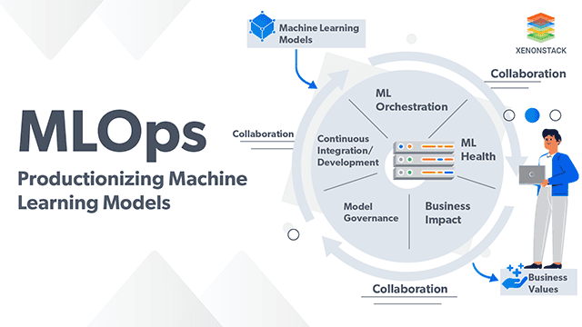
ML Unique Challenge in Production
Dataset dependency
ML ‘black box’ into which many inputs (algorithmic, human, dataset etc.) go to provide output.
Difficult to have reproducible, deterministically ‘correct’ result as input data changes
ML in production may behave differently than in developer sandbox because live data ≠ training data

Slide 21
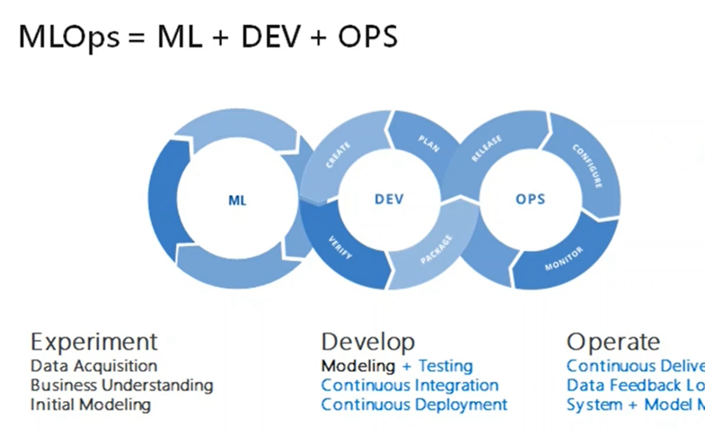
ML Unique Challenge in Production
Multiple loosely coupled pipelines running possibly in parallel, with dependencies and human interactions
Feature engineering pipelines must match for Training and Inference
Further complexity if ensembles, federated learning etc are used

Slide 22
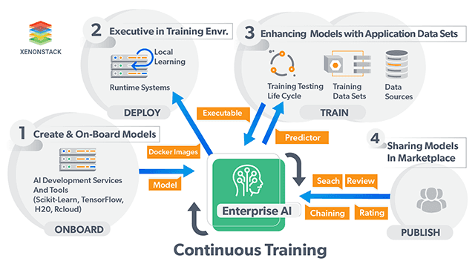
ML Unique Challenge in Production
Possibly differing engines (Spark, TensorFlow, Caffe, PyTorch, Sci-kit Learn, etc. )
Different languages (Python, Java, Scala, R ..)
Inference vs Training engines
Inference (Prediction, Model Serving) can be REST endpoint/custom code, streaming engine, micro-batch, etc.
Feature manipulation done at training needs to be replicated (or factored in) at inference
Each engine presents its own scale opportunities/issues

Slide 23
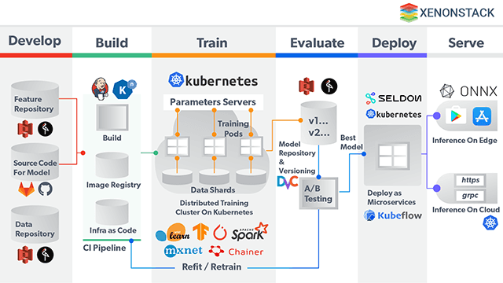
ML Unique Challenge in Production
Model Risk Management
Reproducing and Explaining ML Decisions
Algorithm Fairness Monitoring

Slide 24
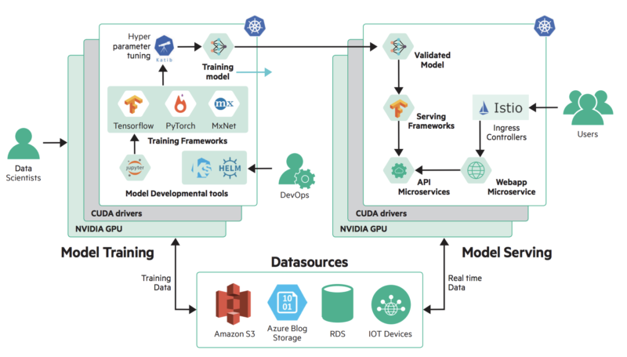
ML Unique Challenge in Production
COLLABORATION
Expertise mismatch between Data Science & Ops complicates handoff and continuous management and optimization
PROCESS
Many objects to be tracked and managed (algorithms, models, pipelines, versions etc.)
ML pipelines are code. Some approach them as code, some not
Some ML objects (like Models and Human approvals) are not best handled in source control repositories

Slide 25
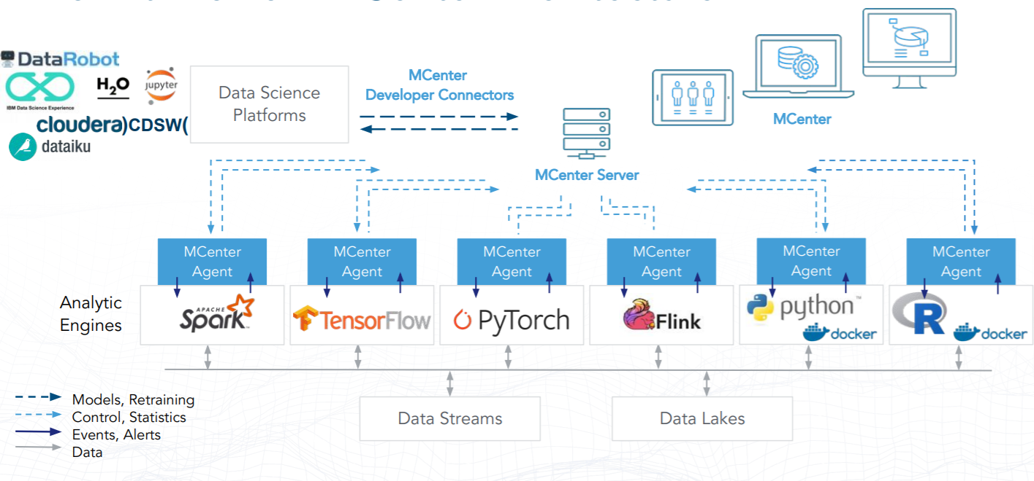
Final MLOps Architecture

Slide 26
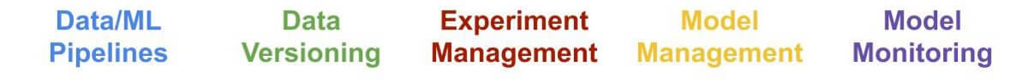


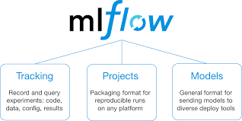
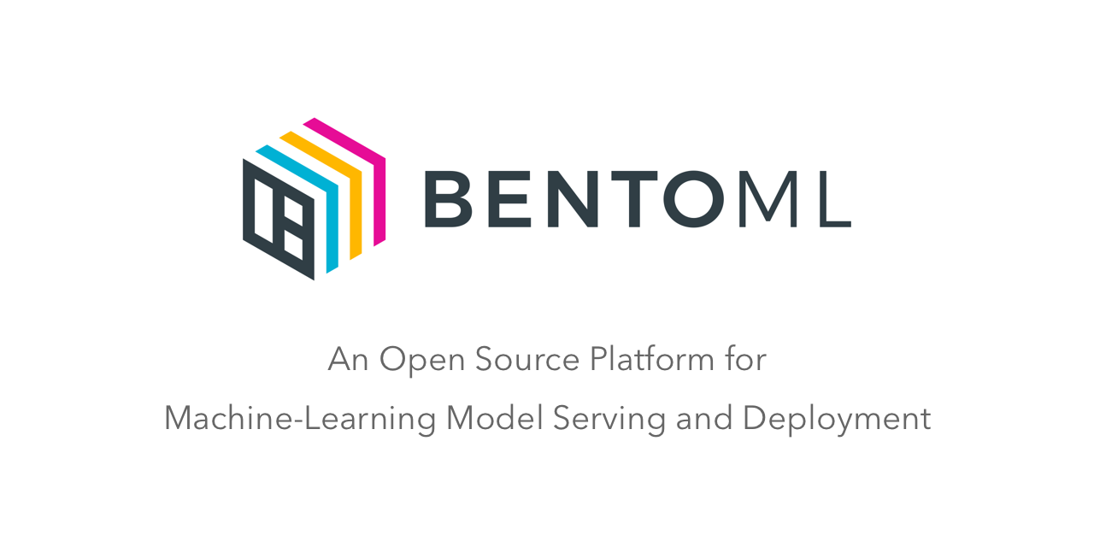


Production ML
Avengers Team

Slide 27
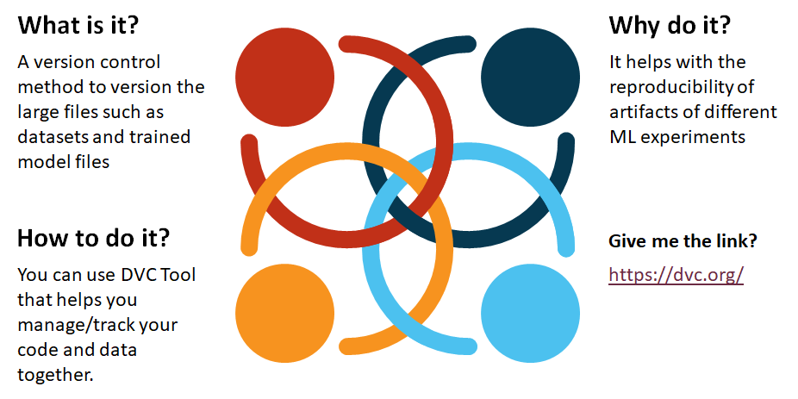
Model & Data Versioning

Slide 28
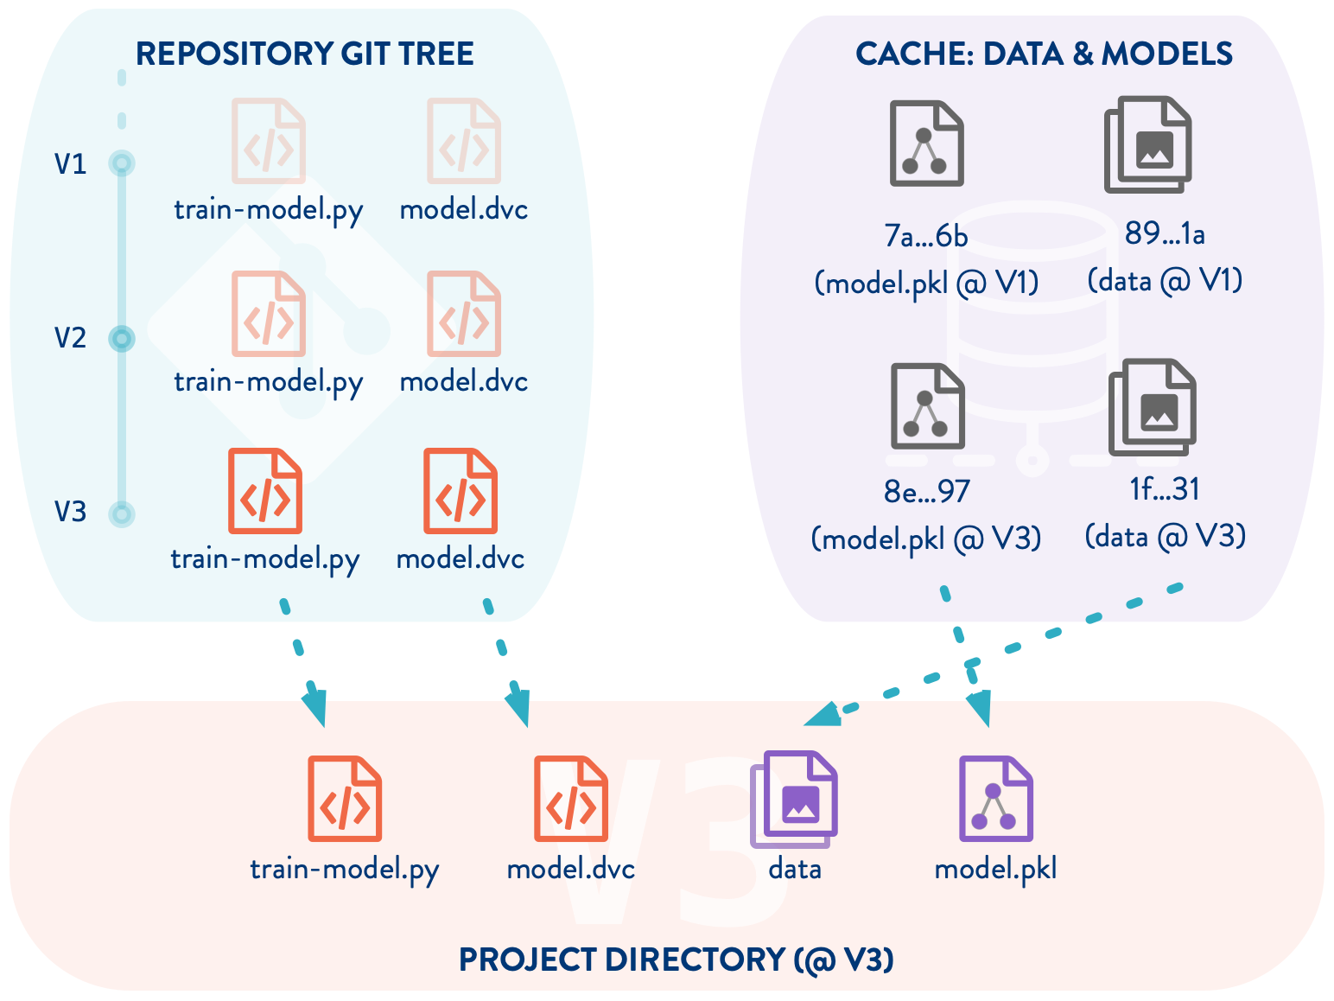
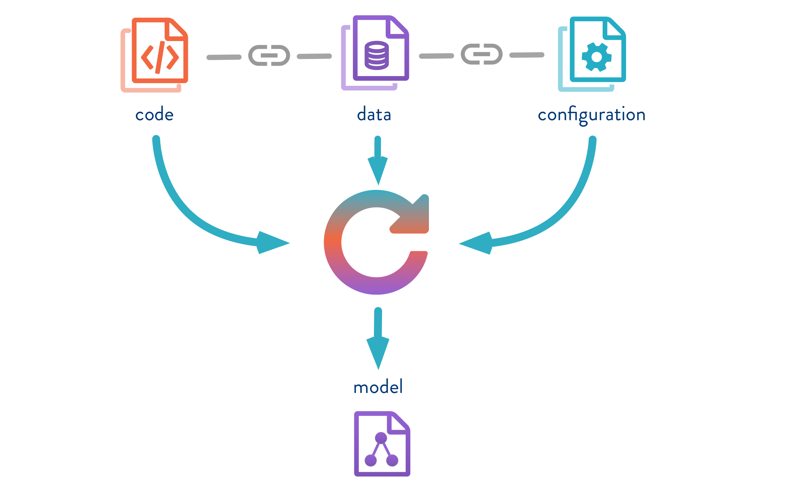
Production in an enterprise

Slide 29
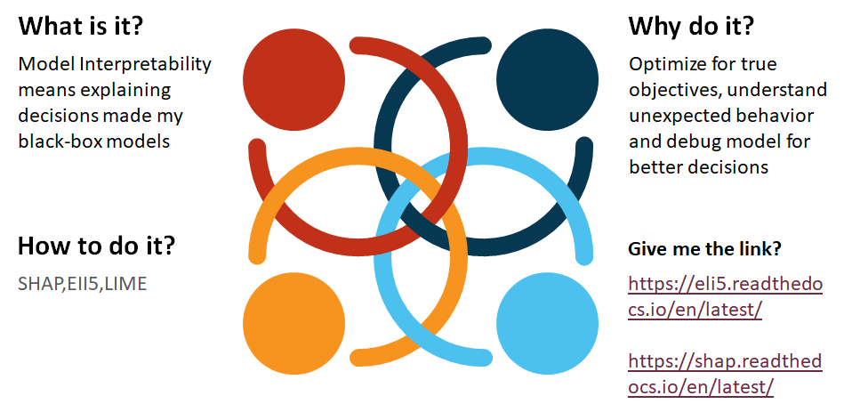
Model Interpretation

Slide 30
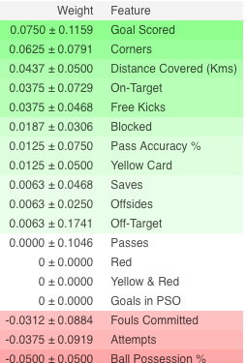
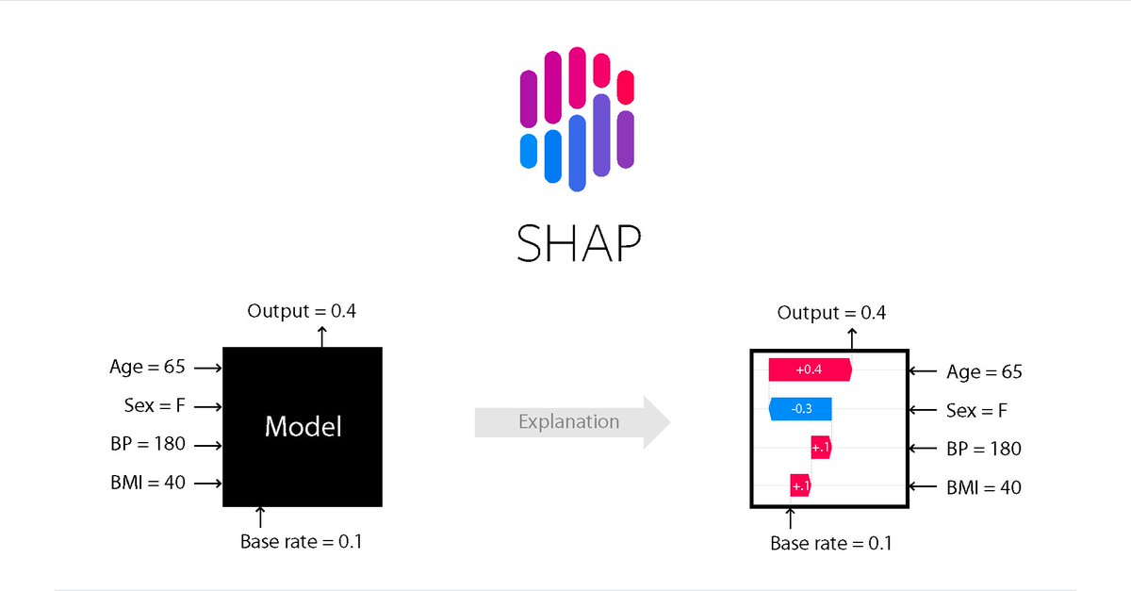
Model Interpretation using SHAP

Slide 31
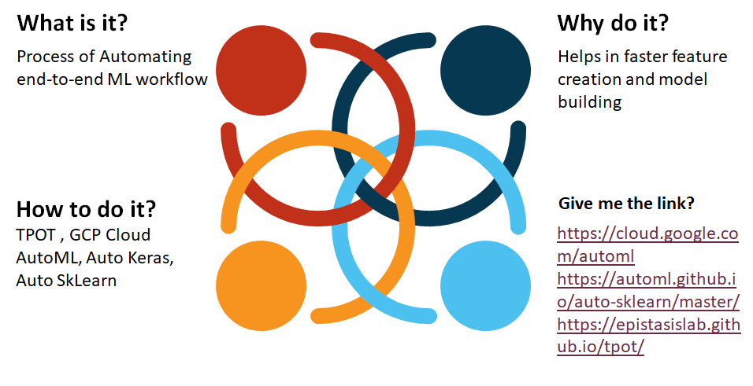
Automated Machine Learning

Slide 32
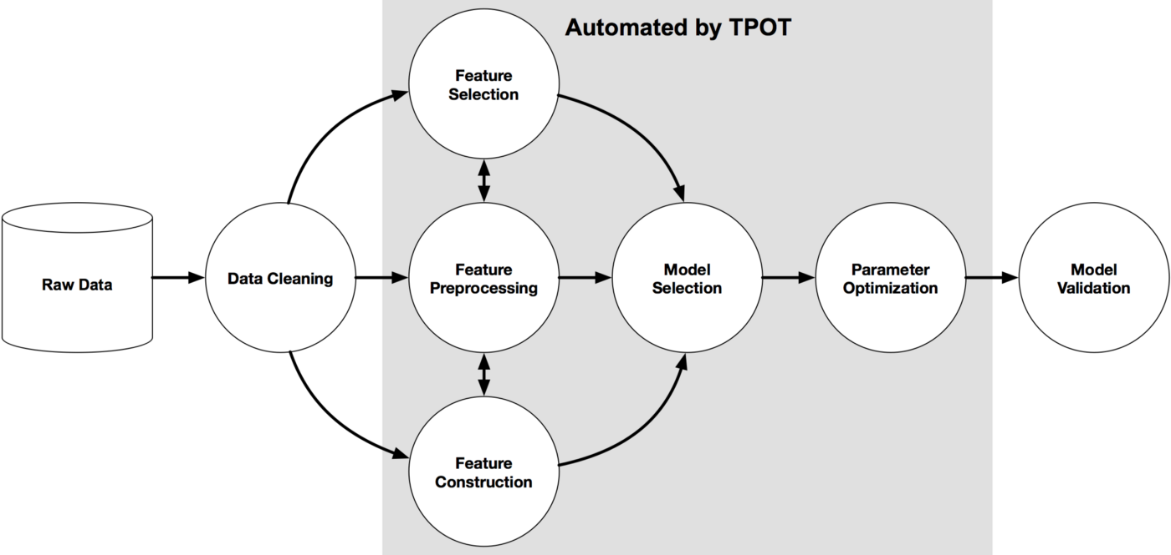
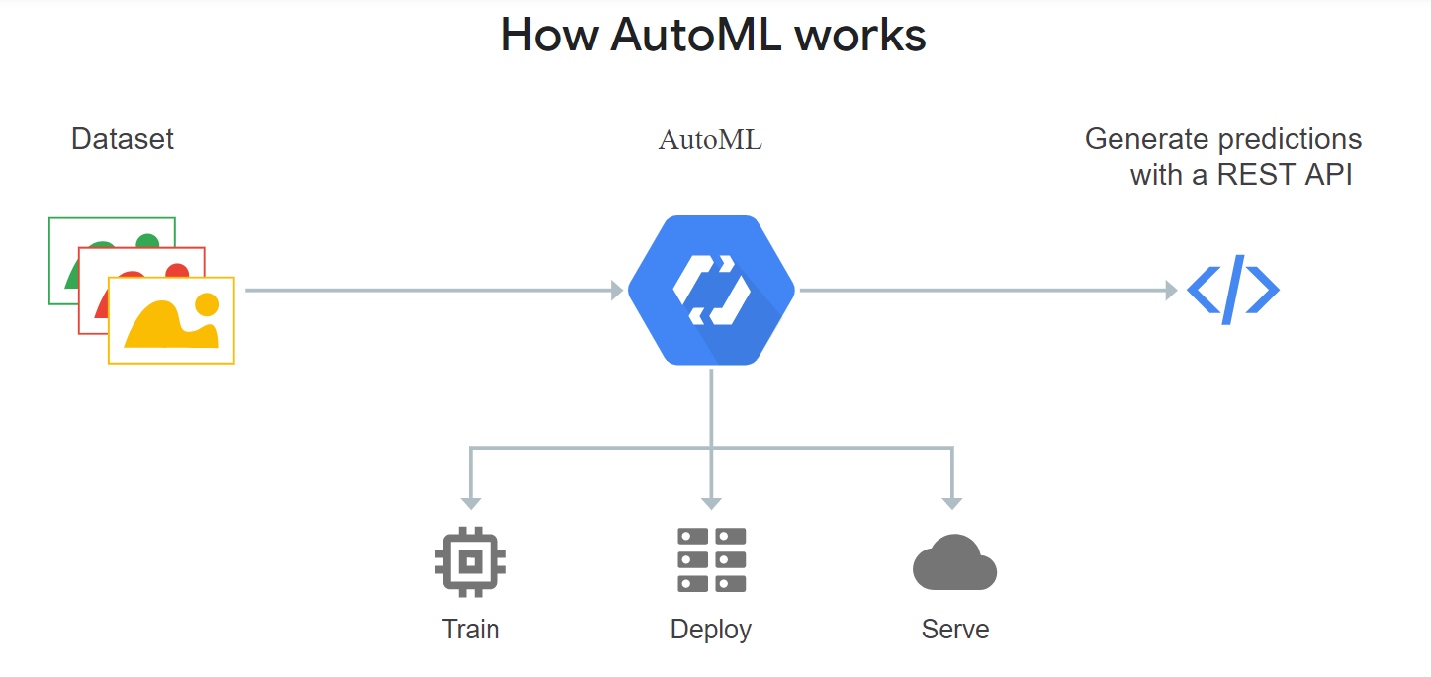
Header

Slide 33
OMG! Stop, I have a question?

Slide 34
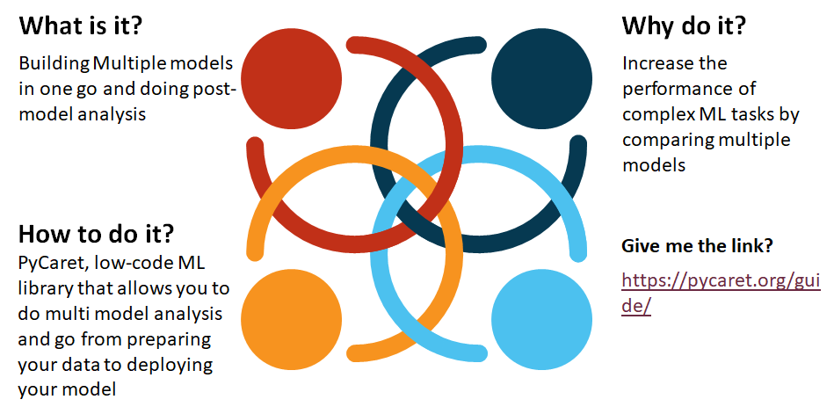
Multi Model Analysis

Slide 35
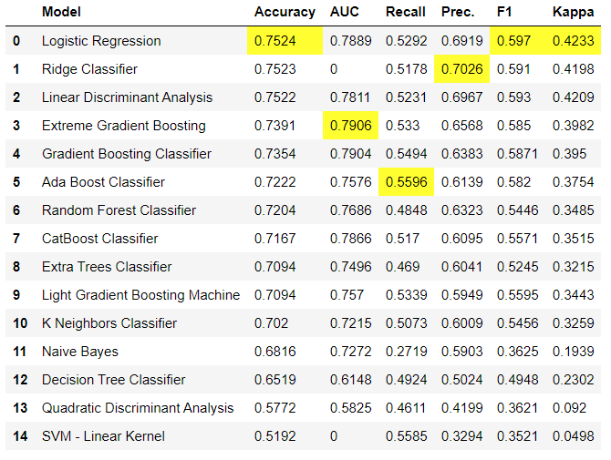
Model Results

Slide 36
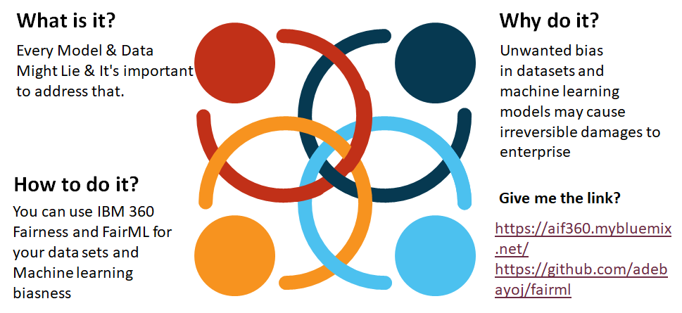
Model and Data Bias

Slide 37
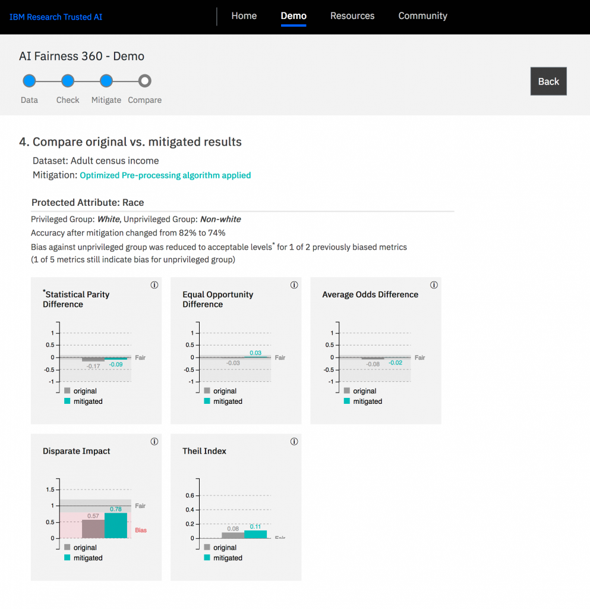
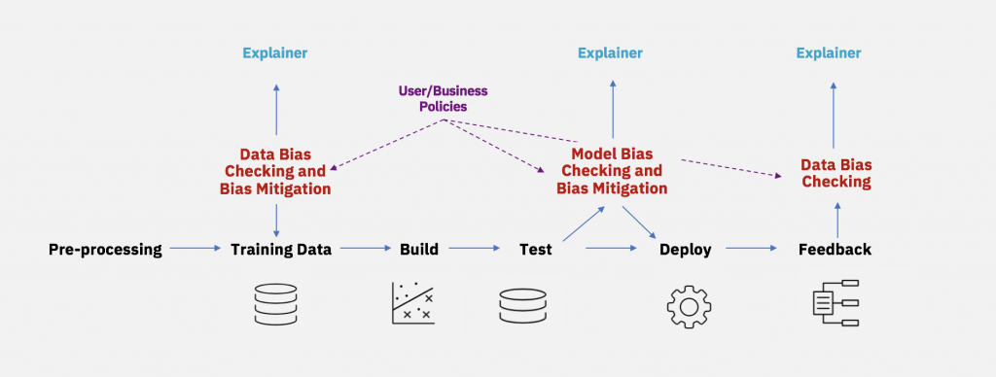

Slide 38
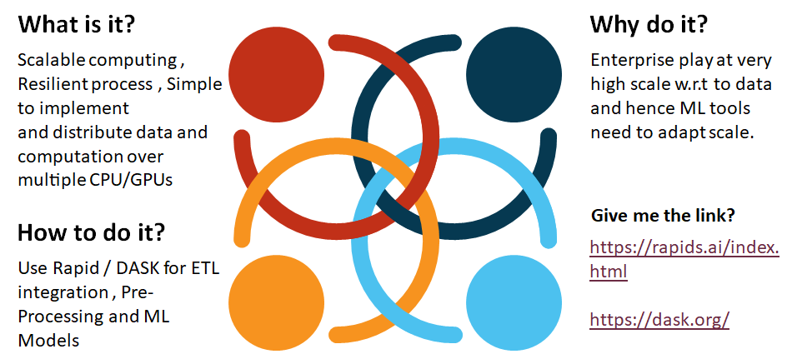
Distributed Data Science

Slide 39
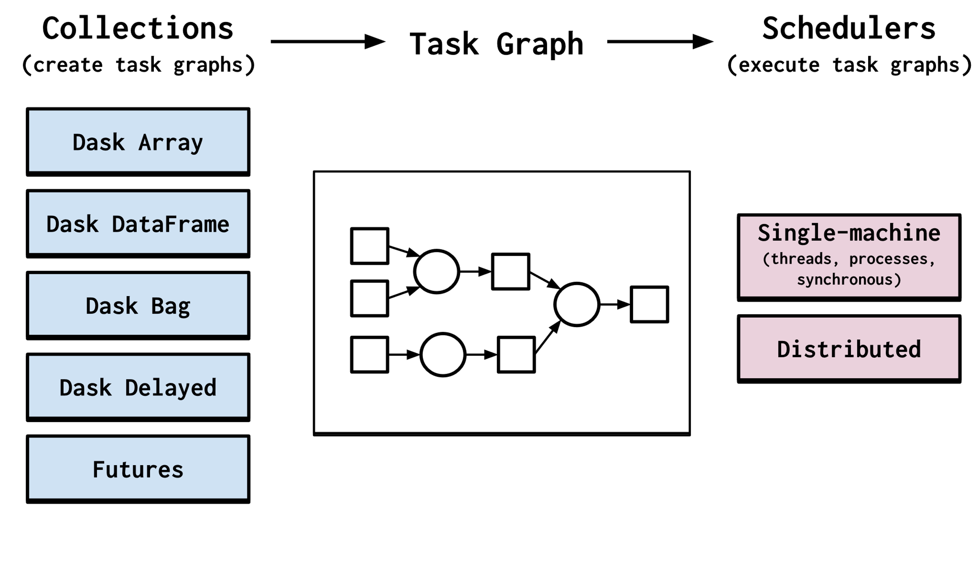
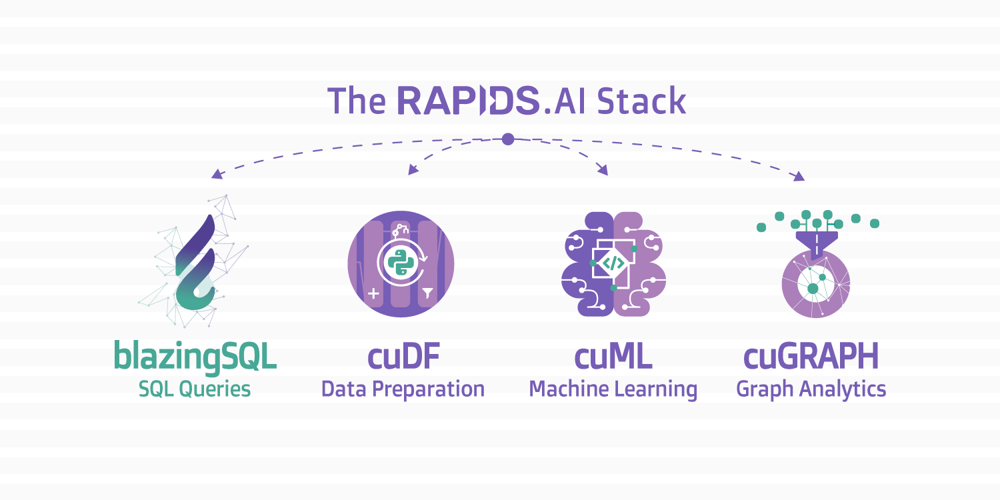

Slide 40
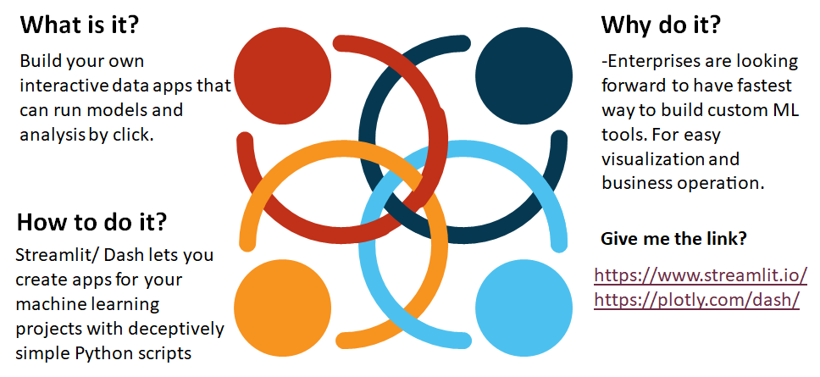
Data Interactive Apps

Slide 41
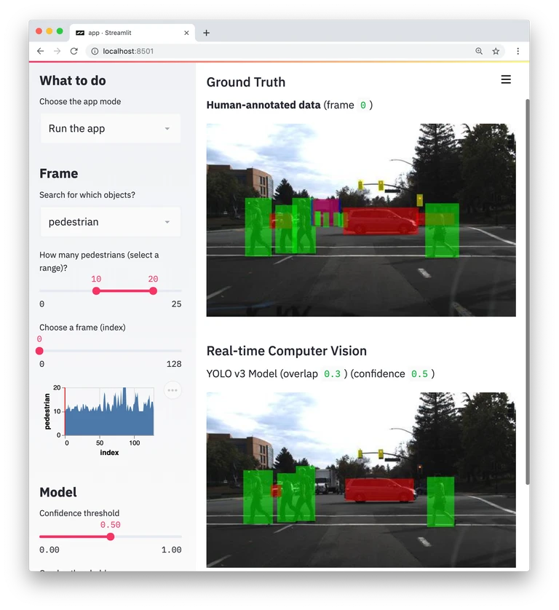
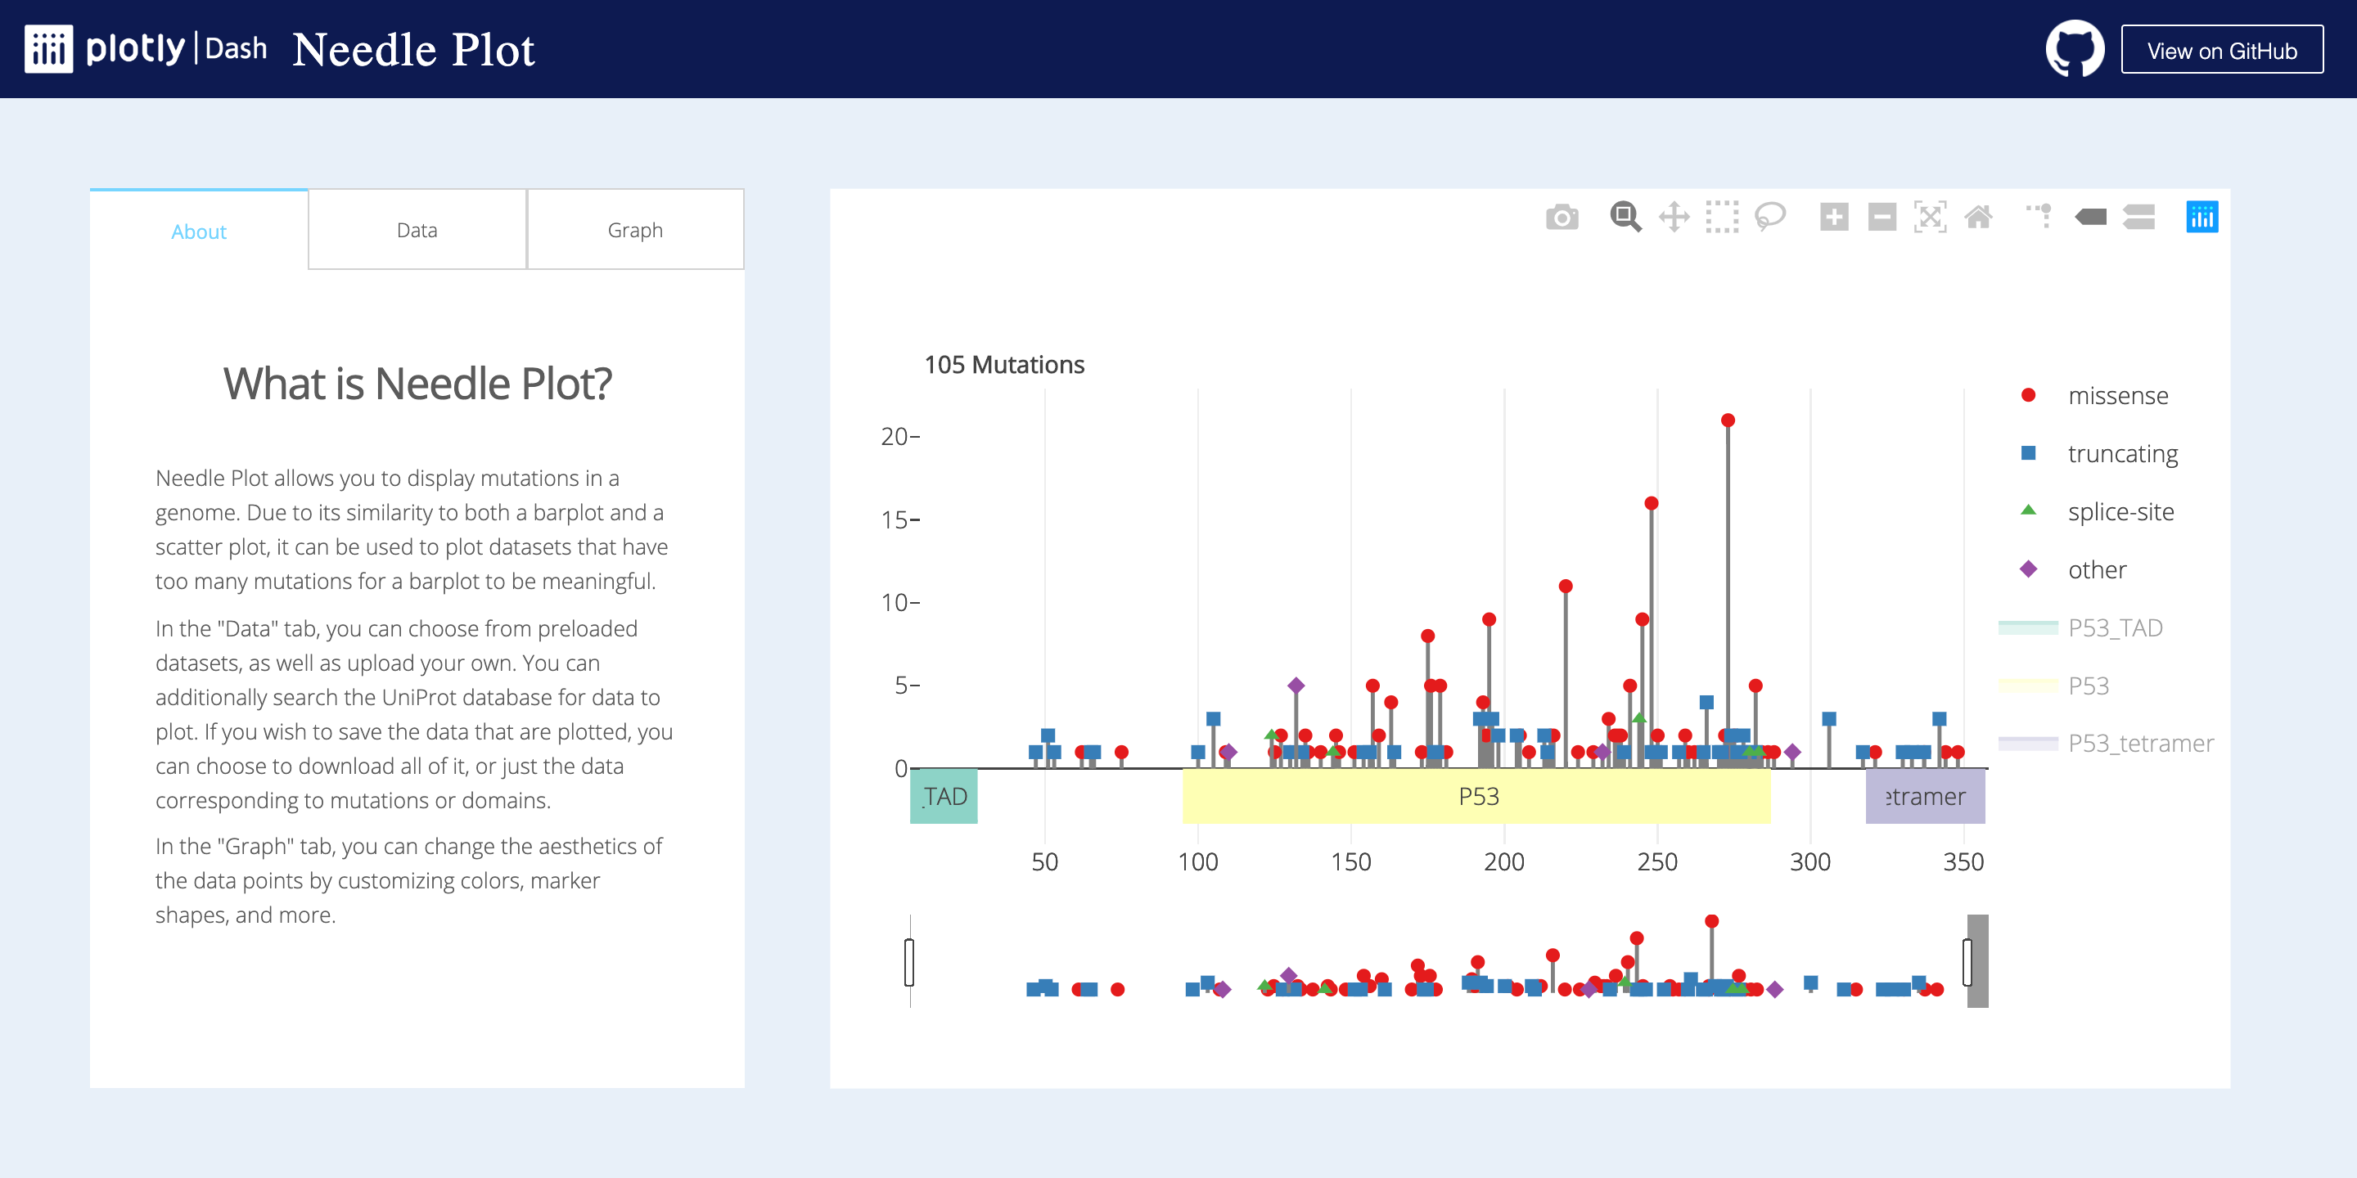

Slide 42
Thank you!

